Slide 1
Binding and Scope
Chapter 3 (skip 3.4-3.5)

Slide 2
Shadowing
Declaration versus definition of vars
int x ←declared, no value
x = 2 ←defined (illegal is not declared)
Nested scope (shadowing
{
int x = 2
{
int x = 3 // complete legal syntax. This x overshadows outer x
print(x) //will print 3
}
}
Normally this is VERY bad form, but becomes needed with some language constructs. Access of the outer blocks’s x will vary with the langauge.
C++ only allow jump to global scope, not outer block with :: (e.g. ::x)

Slide 3
Scope
Formally:
the state where an identifier can be referenced
Already seen local and global scope (access)
Before details…Case examples why Scoping matters
modularity
access level (e.g. private)

Slide 4
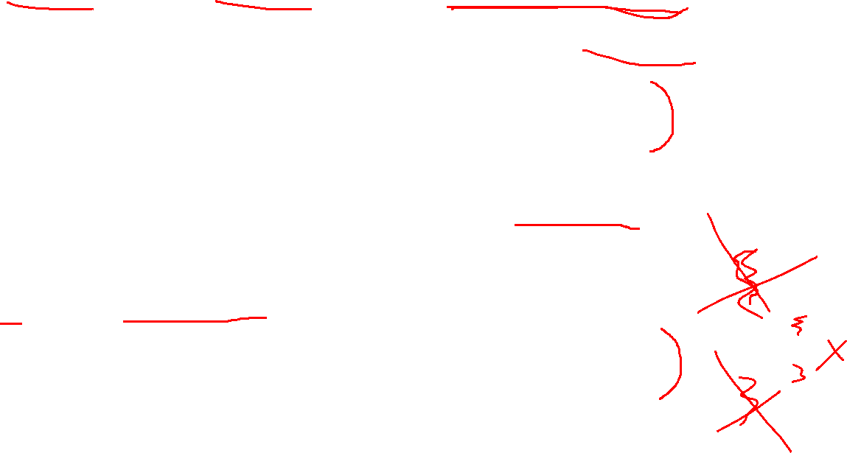
Modules, packages, namespaces
Multiple people want to name their class Picture…what to do…
MS actually had an Image class in their MFC library…without a namespace…
Group them in modules/packages/namespaces which adds an access layer
Lack of access layers can cause issues
The old question of why so many people say
Using namespace std;
In C++ is SO bad…

Slide 5
The issue of Using namespace std;
Importing only what we need limits the risk of conflict
Importing ALL from more than one library is a gigantic increase in risk
This also means that only doing ONE “import all” in C++ is equivalent, so “using namespace std;” by itself has the same level of risk…and is OK
The “forbid it” is a shallow understanding of the problem

Slide 6
As promised
By the way…private helps with this, but it is not a perfect answer
C++ not so private code
Referencing normally refers to what we should (not can) reference)

Slide 7
Two big categories
There is more than static scope that we are used to
Static scope
Can be determined by placement of variables at or before compile time
Dynamic scope
Can be determined by order of run after compile time

Slide 8
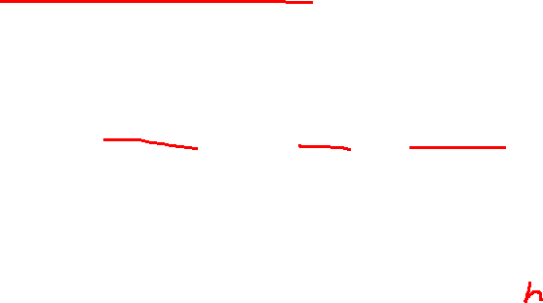
Scope
Static scope
“normal” code
Can be determined by placement of variables
Modern systems, access often granted as long as they in the same block
Earlier systems, you HAD to declare and define everything before it was used
QUESTION: Name an instance where order within a block matters
(think C++ and methods needing to be in call order without prototypes)
Having declaration and definition was the solution for this
QUESTION: Name an instance where it did not
Java classes

Slide 9
Scope
Dynamic scope
Sequence of function calls determine scope
Example of difference
Illegal in static scoped
Func A()
int x
B()
Func B()
x = 2 //ILLEGAL

Slide 10
Scope
Dynamic scope
Legal in dynamic
You can access IF the variable is currently “active.”
E.g.
Func A()
int x
B()
Func B()
x = 2 //can access x here!

Slide 11
Why!!!!!!
The path the compiler checks is different.
(Draw check path)
Static
Dynamic
More on function links later in the semester
Calls
Calls
Main
A
B
Search order
Calls
Calls
Main
A
B
Search order

Slide 12
Dynamic scope
Integer N
func first()
N=1
func second()
Integer N
First()
N = 2
X = getIntInput()
if x > 0
second()
else
first()
print n
←Example from book on why dynamic scope is tricky, and closures are favored in more modern languages
QUESTION
What happens with a negative and positive input in static scope?
What happens with a negative and positive input in dynamic scope?
We will come back to closures in a just a bit

Slide 13
Dynamic scope
Static scope would print 1, period.
Dynamic would print a 2 is the input is positive, and 1 other wise
Why? In static scope, N in first is mapped to the global N regardless. In dynamic, the run path has second()’s N closer so it updates N in second!

Slide 14
Reference environment and Closure
Start here

Slide 15
Reference environment
Visible names at a given environment
For C++ and Java we usually think of this as all the CURRENT variables from outermost nesting to the current block
Closures, shallow binding, and deep binding wreak havoc on this assumption

Slide 16
Reference environment
shallow binding
Similar to lazy initialization, reference environment is created at call time (more common in dynamic scoping)
deep binding/closure
Current reference environment is created when the function is used as an argument time (most static scoped languages)
Closures
A SAVED reference environment that may not be the current one along with the function that uses it
VERY important with nested functions
Static\dynamic scoping, and deep\shallow binding can be in any combo

Slide 17
What is affected; some terminology
First some terminology
First class object
Can be assigned to a variable, passed into a function, and returned from a function
First class functions regularly occurs in dynamic languages
Second class object:
Can be passed into a function
Third class object
Can’t even be passed in (usually syntax)

Slide 18
Closure and Nesting functions
OK, now for something a bit weird
As soon as we have a nested function, the “closure” tells us what it can access
MOST languages also support passing functions in some form

Slide 19
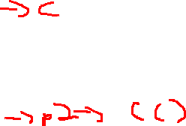
Closure and Nesting functions
def A(){
integer d = 2
def C(){
Print (d) //point X
Return C
def B()
d = 3 //point Y
foo = A()
return foo
main()
integer d
d = 4
foo2 = B()
foo2() //point Z
Who has access to what in a nested function?
Note to self: draw box to represent the saved reference state of C when it is made
Notes:
sub A{ my $d = 2; $C = sub{ print (d); #point X }; return $C;}sub B{ $d = 3; #point Y $foo = A(); print($foo); #&$foo(); return $foo;}$d = 4;$foo2 = B();#&$foo2(); #point Z

Slide 20
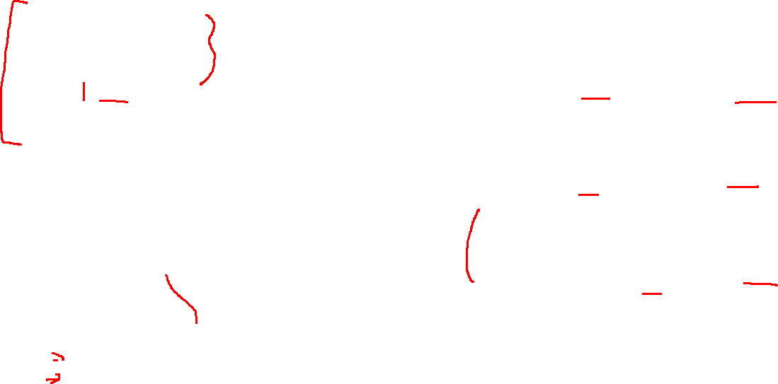
Closure and Nesting functions
def A(){
integer b = 2
def C(){
Print (b) //point X
Return C
def B()
b = 3
//point Y
p = A()
return p
main()
integer b
b = 4
p2 = B()
p2() //point Z
Options:
Just the function
Static scope + shallow bind
All variables in an outer block (Python)
Static scope + deep binding
All variables from the caller the function when made
dynamic scoping + deep binding
Everything made afterwards?
dynamic scoping + shallow binding
Note to self: draw box to represent the saved reference state of C when it is made

Slide 21
Closure and Nesting functions
def A(){
integer d = 2
def C(){
Print (d) //point X
Return C
def B()
d = 3
print(d)//point Y
foo = A()
return foo
main()
integer d = 4
foo2 = B()
foo2()
print(d) //point Z
Option 1
Static scope + shallow bind
Result just the function can be access
X: d not declared → fail
Y: d not declared → fail
Z: d= 4 (from main)
Notes:
sub A{ #my $d = 2; $C = sub{ print("\nX: " . $d); #point X }; return $C;}sub B{ #$d = 3; #point Y GLOBAL in perl print("\nY: " . $d); $foo = A(); return $foo;}sub main(){ my $d = 4; $foo2 = B(); &$foo2(); #point Z print("\nZ: " . $d);}main();

Slide 22
Closure and Nesting functions
def A(){
integer d = 2
def C(){
Print (d) //point X
Return C
def B()
d = 3
print(d)//point Y
foo = A()
return foo
main()
integer d = 4
foo2 = B()
foo2()
print(d) //point Z
Options 2
Static scope + deep binding
All variables in an outer block (Python)
X: d=2 (enclosed by A at creation)
Y: d not declared → fail
Z: d= 4 (from main)

Slide 23
Closure and Nesting functions
def A(){
integer d = 2
def C(){
Print (d) //point X
Return C
def B()
d = 3
print(d)//point Y
foo = A()
return foo
main()
integer d = 4
foo2 = B()
foo2()
print(d) //point Z
Options 3
dynamic scoping + deep binding
All variables from the caller the function when made
X: d=2 (enclosed by A at creation)
Y: d not declared → fail
Z: d= 4 (from main)

Slide 24
Closure and Nesting functions
def A(){
integer d = 2
def C(){
Print (d) //point X
Return C
def B()
d = 3
print(d)//point Y
foo = A()
return foo
main()
integer d = 4
foo2 = B()
foo2()
print(d) //point Z
Options 4
dynamic scoping + shallow binding
Everything in current call chain
X: d=2 (enclosed by A at creation in call path)
Y: d=3
Z: d= 4 (from main)

Slide 25
Closure and Nesting functions
Another example
In Ruby, we can save a block, and when it is called, it has access to the variables in WHATEVER block called it (not made it!)
This is static scope with shallow binding
Python actually has some special syntax to allow a similar effect

Slide 26
Practice: Closures
Assume dynamic scoping with closure
Def A(x, P):
Def B():
Print(x)
If x > 1:
P()
Else:
A(2,B)
//just to make the compiler happy…
//could pass in null instead
Def C()
Pass
A(1, C)
QUESTION: What does this print?

Slide 27
Closures
This will print 1!
Why? When A(1,C) is call, the current reference environment is saved for C. That means when C is called, X will be stack as 1

Slide 28
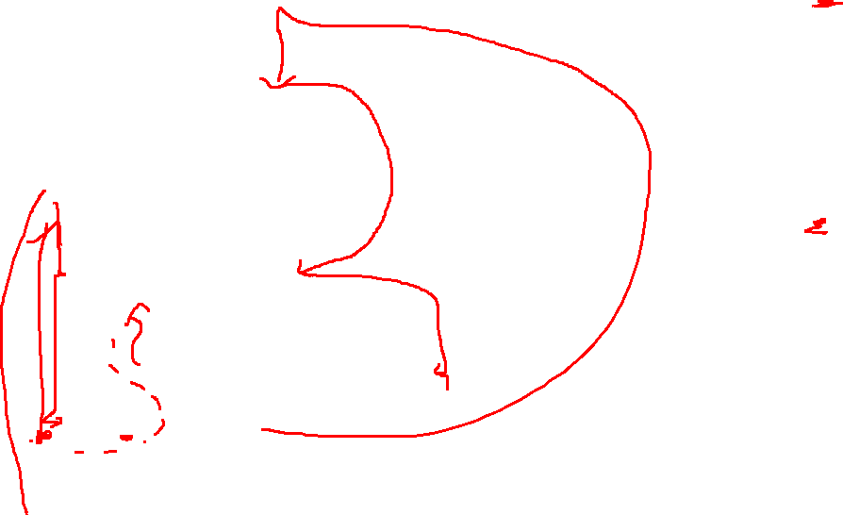
Practice: Closure
Func A(P)
int x = 1
P()
Func C(x):
int y = 2
func B():
int z = 3
Print(x, y, z)
A(B)
C(0)
Dynamic scoping without closure?
Dynamic scoping with closure?

Slide 29
Practice: Closure
Func A(P)
int x = 1
P()
Func C(x):
int y = 2
func B():
int z = 3
Print(x, y, z)
A(B)
C(0)
Dynamic scoping without closure?
Prints: 1, 2, 3
Dynamic scoping with closure?
Prints: 0, 2, 3

Slide 30
Last note: Closures
Closures issues are less common in languages that forbid nested functions
BUT still can be get the same effect with, interfaces, operator overloading and lambdas!
QUESTION: How?

Slide 31
Projection

